Slide 1
Supervised Learning - Classification

Slide 2
Supervised learning (classification)
Supervision: The training data (observations, measurements, etc.) are accompanied by labels indicating the class of the observations
Predicts categorical class labels (discrete or nominal)
classifies data (constructs a model) based on the training set and the values (class labels) in a classifying attribute and uses it in classifying new data

Slide 3
Classification
Given a collection of records (training set )
Each record contains a set of attributes, one of the attributes is the class.
Find a model for class attribute as a function of the values of other attributes.
Goal: previously unseen records should be assigned a class as accurately as possible.
A test set is used to determine the accuracy of the model. Usually, the given data set is divided into training and test sets, with training set used to build the model and test set used to validate it.

Slide 4
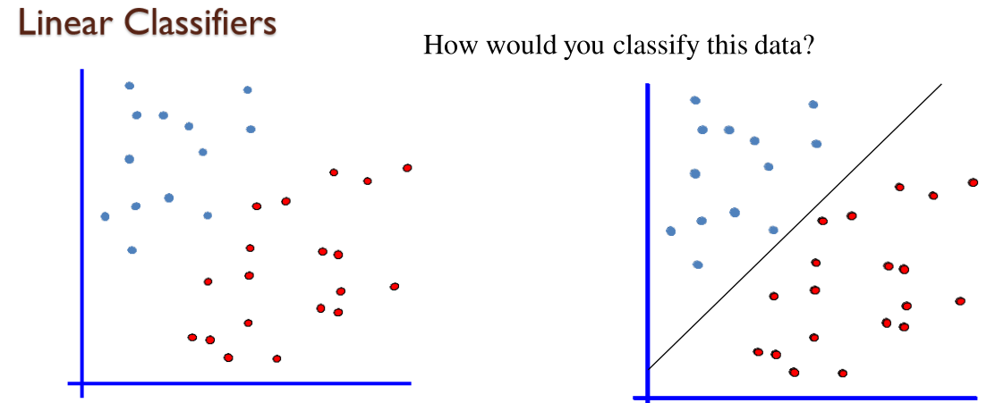

Slide 5
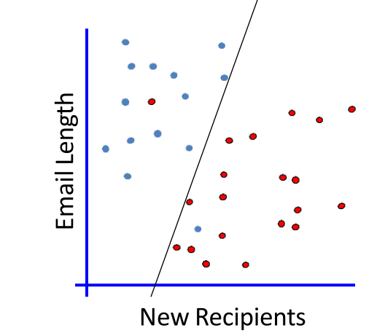
No linear classifier cover all instances

Slide 6
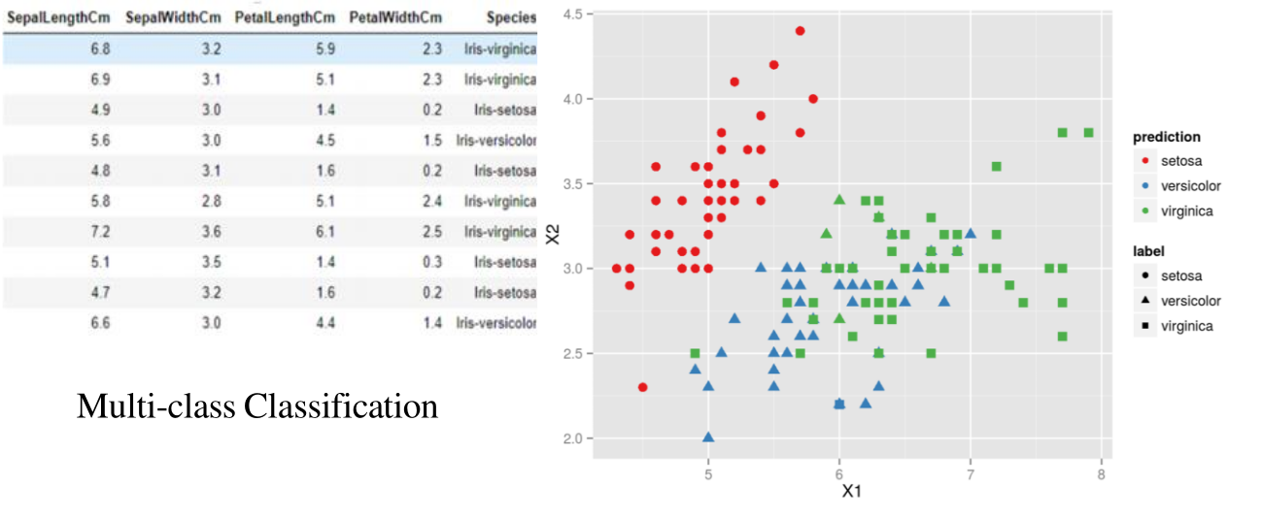

Slide 7
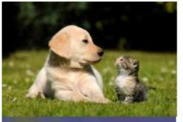
Multi label classifier(dog and dog variety) or (cat and cat variety)

Slide 8
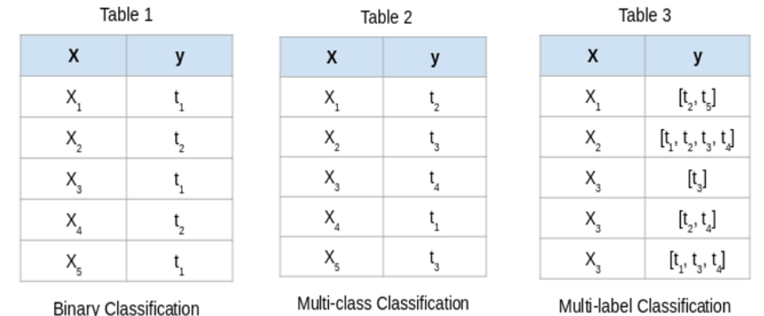

Slide 9
Classification—A Two-Step Process
Model construction: describing a set of predetermined classes
Each tuple/sample is assumed to belong to a predefined class, as determined by the class label attribute
The set of tuples used for model construction is training set
The model is represented as classification rules, decision trees, or mathematical formulae
Model usage: for classifying future or unknown objects
Estimate accuracy of the model
The known label of test sample is compared with the classified result from the model
Accuracy rate is the percentage of test set samples that are correctly classified by the model
Test set is independent of training set, otherwise over-fitting will occur
If the accuracy is acceptable, use the model to classify data tuples whose class labels are not known
2

Slide 10
Process (1): Model Construction
Classification
Algorithms
Training
Data
Classifier
(Model)
IF rank = ‘professor’
OR years > 6
THEN tenured = ‘yes’
9

Slide 11
Process (2): Using the Model in Prediction
Classifier
Testing
Data
Unseen Data
(Jeff, Professor, 4)
Tenured?
9

Slide 12
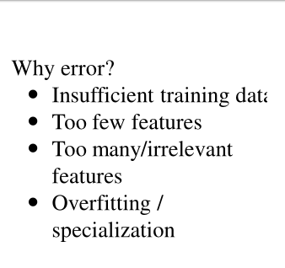

Slide 13
Types of bayesian classifier
Naive Bayes Classifier: Assumes conditional independence of features. It selects the class that has the greatest posterior probability of happenings.
Gaussian Naive Bayes (GNB): Assumes features follow a normal (Gaussian) distribution, suitable for continuous data like height or temperature.
Multinomial Naive Bayes (MNB): Used for discrete features, often word counts in text. It calculates probabilities based on the frequency of features.
Bernoulli Naive Bayes (BNB): Ideal for binary features (present/absent). It checks if a word appears in a document, rather than how many times.

Slide 14
Bayesian Classification: Why?
A statistical classifier: performs probabilistic prediction, i.e., predicts class membership probabilities
Foundation: Based on Bayes’ Theorem.
Performance: A simple Bayesian classifier, naïve Bayesian classifier, has comparable performance with decision tree and selected neural network classifiers
Incremental: Each training example can incrementally increase/decrease the probability that a hypothesis is correct — prior knowledge can be combined with observed data
Standard: Even when Bayesian methods are computationally intractable, they can provide a standard of optimal decision making against which other methods can be measured
13
Notes:
<number>

Slide 15
Bayesian Theorem: Basics
Let X be a data sample (“evidence”): class label is unknown
Let H be a hypothesis that X belongs to class C
Classification is to determine P(H|X), the probability that the hypothesis holds given the observed data sample X
P(H) (prior probability), the initial probability
E.g., X will buy computer, regardless of age, income, …
P(X): probability that sample data is observed
P(X|H) , the probability of observing the sample X, given that the hypothesis holds
E.g., Given that X will buy computer, the prob. that X is 31..40, medium income
14

Slide 16
Bayesian Theorem
Given training data X, posteriori probability of a hypothesis H, P(H|X), follows the Bayes theorem
Informally, this can be written as
posteriori = likelihood x prior/evidence
Predicts X belongs to C₂ iff the probability P(C_{i}|X) is the highest among all the P(C_{k}|X) for all the k classes
Practical difficulty: require initial knowledge of many probabilities, significant computational cost
15

Slide 17
Naive Bayes Classification
Let D be a training set of tuples and their associated class labels.
Tuple is represented by an n-dimensional attribute vector,
X = (x1, x2,..., xn),
Measurements made on the tuple from n attributes, respectively, A1, A2,..., An

Slide 18

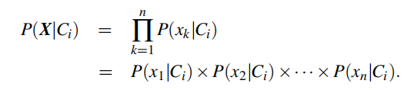

Naive Bayes Classification
Naïve Bayesian classifier predicts that tuple X belongs to the class C_{i}, if and only if
Bayes’ theorem

Slide 19
Naive Bayes - Example

Slide 20
Classify the following x,
Prior probability
P(buys computer = yes) = 9/14 = 0.643
P(buys computer = no) = 5/14 = 0.357

Slide 21
Conditional Probability
P(age = youth | buys computer = yes) = 2/9 = 0.222
P(age = youth | buys computer = no) = 3/5 = 0.600
P(income = medium | buys computer = yes) = 4/9 = 0.444
P(income = medium | buys computer = no) = 2/5 = 0.400
P(student = yes | buys computer = yes) = 6/9 = 0.667
P(student = yes | buys computer = no) = 1/5 = 0.200
P(credit rating = fair | buys computer = yes) = 6/9 = 0.667
P(credit rating = fair | buys computer = no) = 2/5 = 0.400

Slide 22
P(X|buys computer = yes) =
P(age = youth | buys computer = yes) ×
P(income = medium | buys computer = yes) ×
P(student = yes | buys computer = yes) ×
P(credit rating = fair | buys computer = yes)
= 0.222×0.444×0.667×0.667 = 0.044.

Slide 23
P(X|buys computer = no) = 0.600×0.400×0.200×0.400 = 0.019.
To find the class, Ci, that maximizes P(X|Ci)P(Ci), Compute
P(X|buys computer = yes)*P(buys computer = yes) = 0.044×0.643
= 0.028
P(X|buys computer = no)*P(buys computer = no) = 0.019×0.357
= 0.007
Naïve Bayesian classifier predicts buys computer = yes for tuple X.

Slide 24
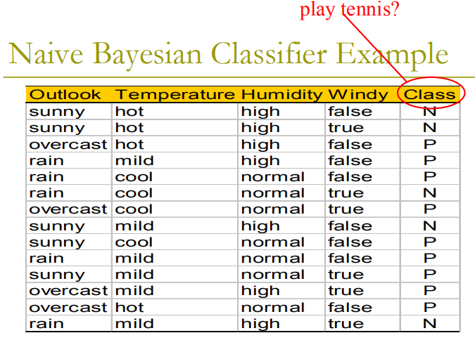
Practice Question???

Slide 25
Classify a new sample X
X =
 outlook = sunny
 temperature = cool
 humidity = high
 windy = false
Play Tennis = ?

Slide 26
Naive Bayes Classification-Laplace smoothing
Naïve Bayesian classifier predicts that tuple X belongs to the class C_{i}, if and only if
Bayes’ theorem

Slide 27
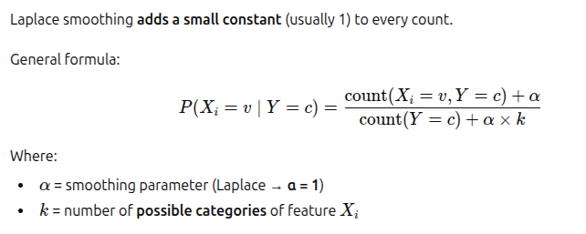
Laplace smooth – To avoid zero probability

Slide 28
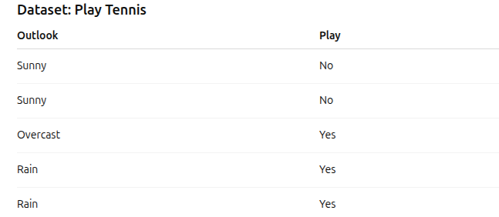
Laplace smooth
Example

Slide 29
